Slide 1
Geography March 29th

Slide 2
Starter
To spend time with their family
To explore new countries
To experience new climate
To get away for people that they hate

Slide 3
Pictures
Pyramids of Giza, Egypt
Taj Mahal, India
Disney land, America
Tower of London, London
Eiffel tower, Nepal
Niagara falls, Canada
Grand canyon, America
Las Vegas, America
Great Barrier reef, Australia
Mount Everest, Nepal

Slide 4
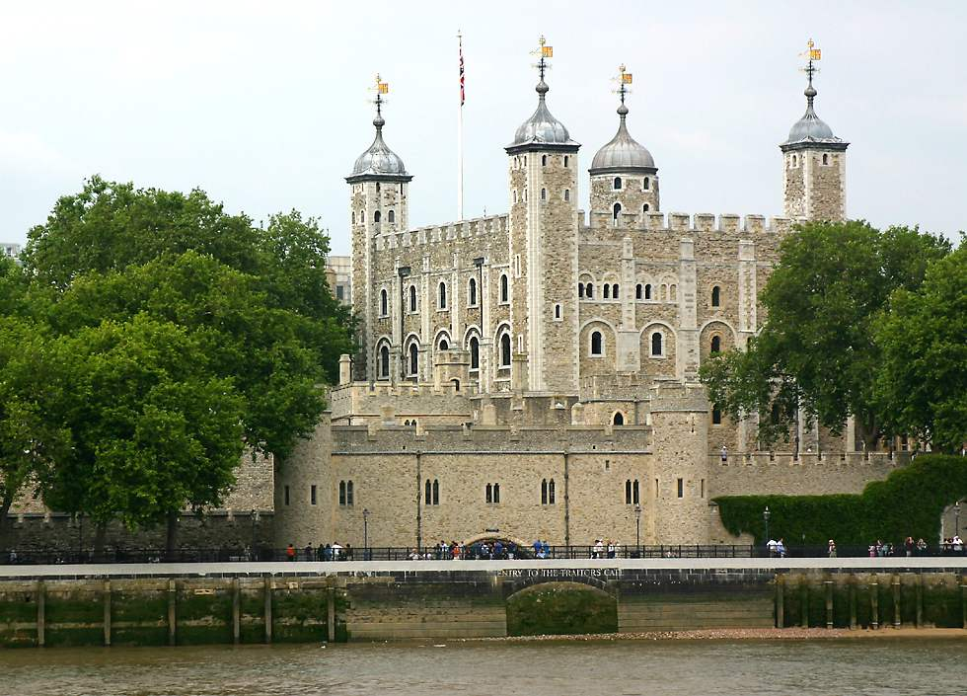
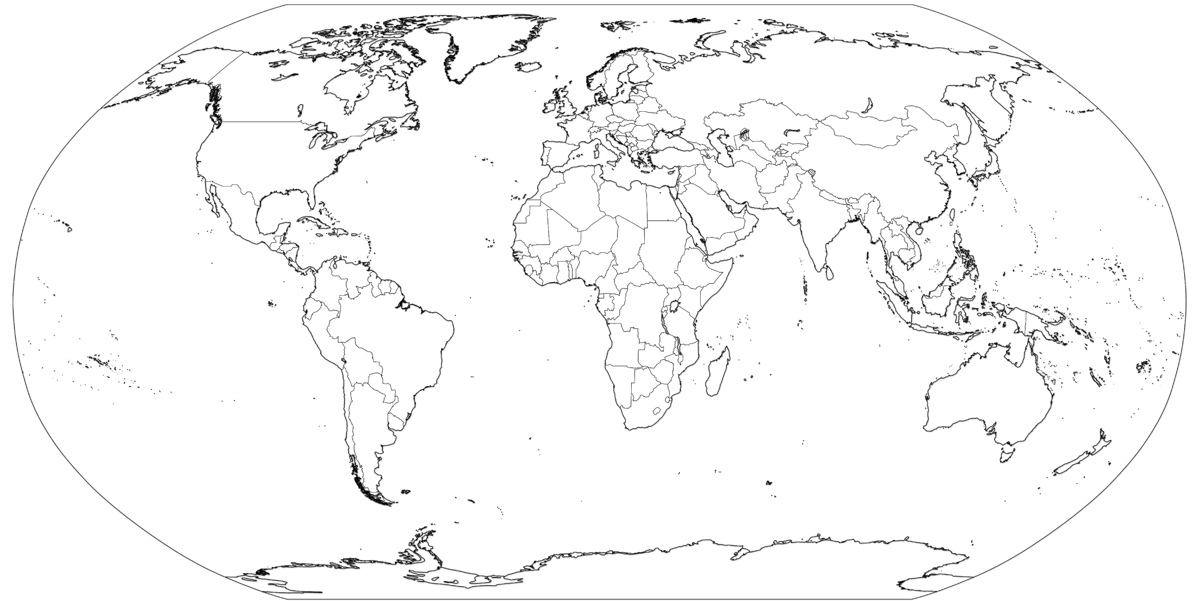
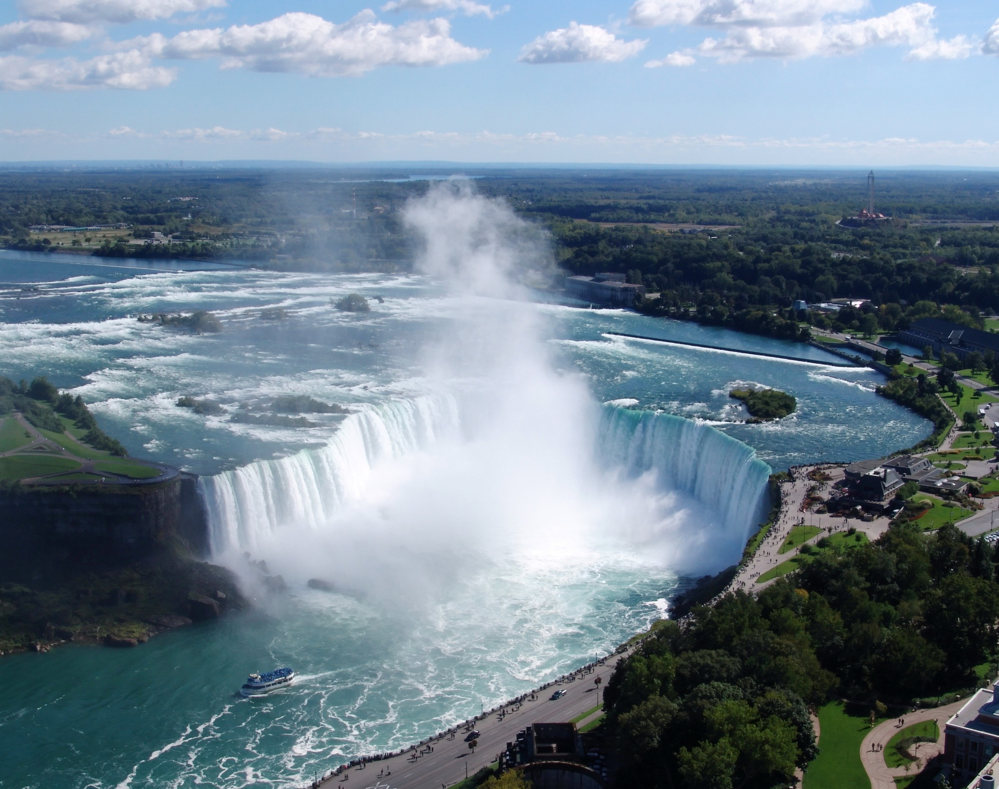
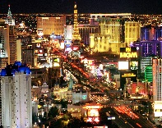
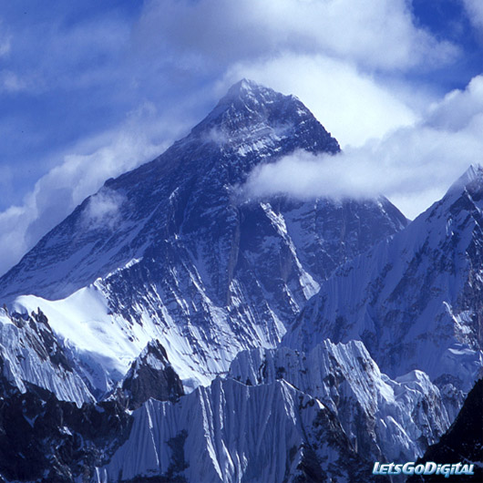
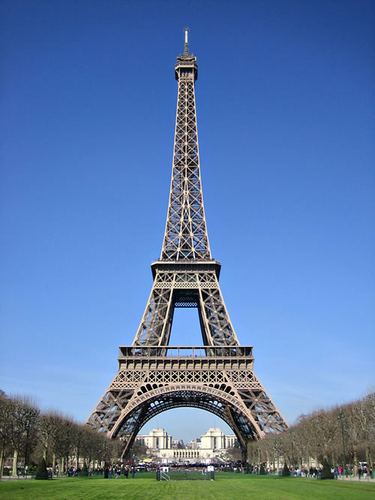
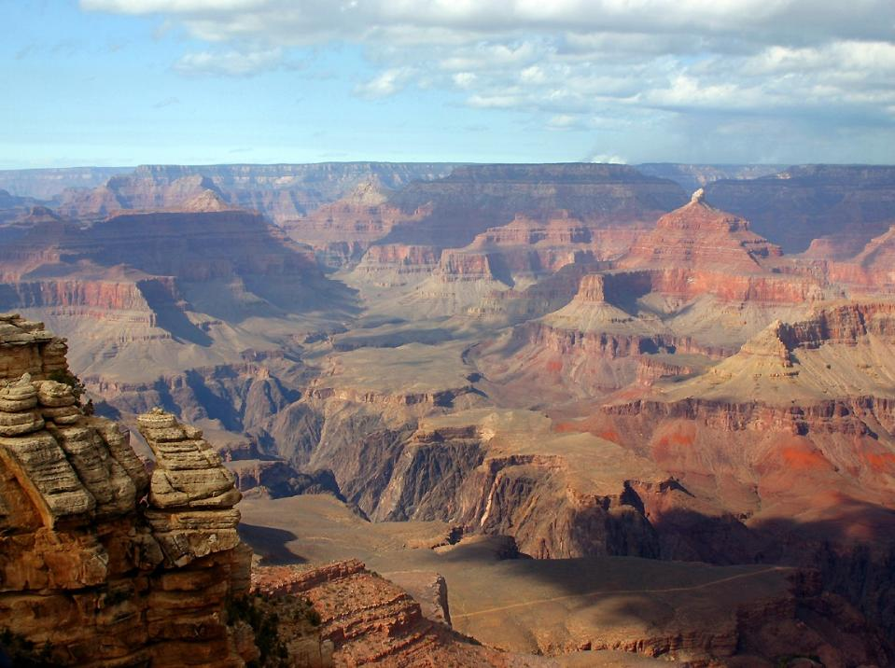
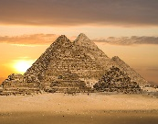
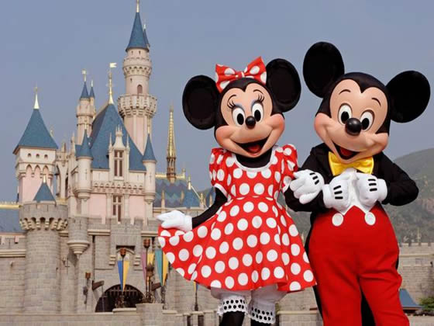
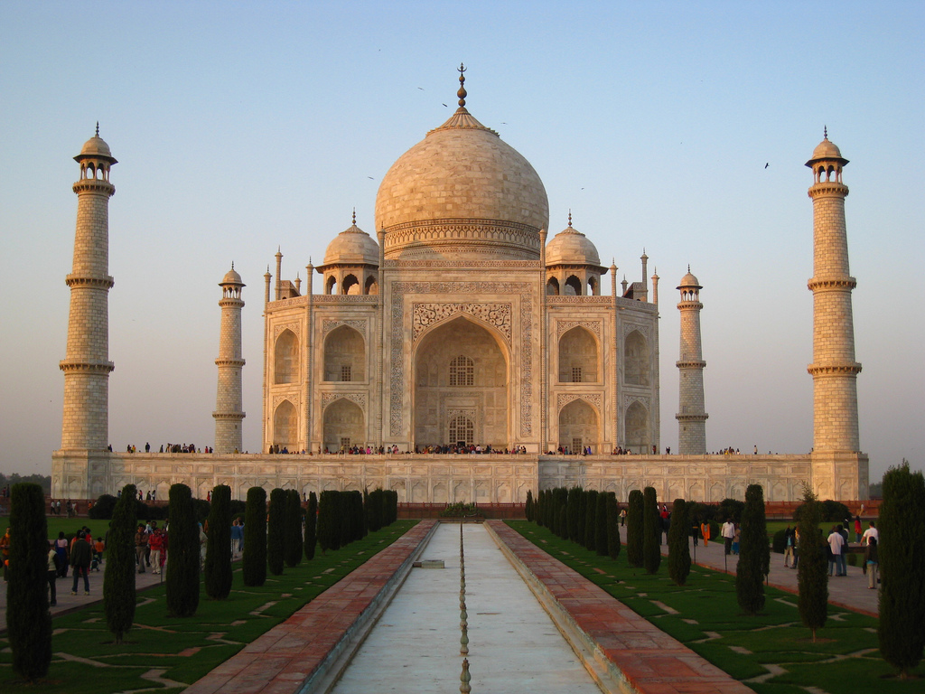
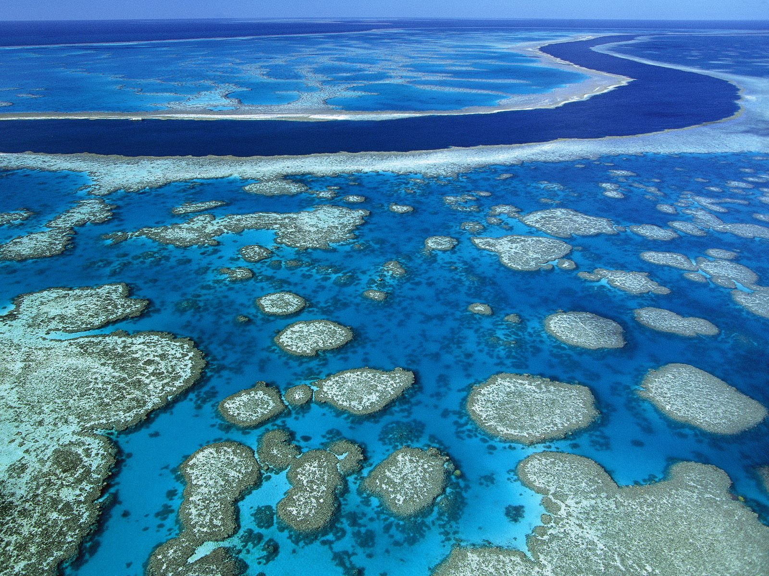
Map to show locations of 10 important tourist destinations
KEY
1. Pyramids, Egypt 4. Tower of London, UK 7. Grand Canyon, USA 10. Mount Everest, Nepal
2. Taj Mahal, Egypt 5. Eiffel Tower, France 8. Las Vegas, USA
3. Disney Land, America 6. Niagara Falls, Canada 9. Great Barrier Reef, Australia
4
6
5
8
7
3
1
10
2
9

Slide 5
Where would you like to go?
I would go to the great barrier reef due to the amount of marine I would see. It would be the best experience for anyone.

Slide 6
Describing the holiday
The best holiday that I ever went on was in Spain. It was good because I played tennis with great people. I ate tasty Spanish food. The most memorable part was the clean air and the weather. It was so serene and the air was so clean. The thing that was not good was the drivers, they always caused problems and it was hard being on the highway. It would have been better if the roads were emptier.

